Slide 1
Vector Differentiation

Slide 2
Content
Introduction to vector function
Geometric interpretation of vector function in 2D & 3D
Scalar point function
Vector point function
Vector differential operator Del
Action of Del on scalar point and vector point functions
Gradient
Directional Derivative
Divergence and Curl
Scalar Potential

Slide 3
Difference between Scalar & Vector
 | Vector | Scalar
Definition | A physical quantity with both the magnitude and direction. | A physical quantity with only magnitude.
Representation | A number (magnitude), direction using unit cap or arrow at the top and unit. | A number (magnitude) and unit
Symbol | Quantity symbol in bold and an arrow sign above | Quantity symbol
Direction | Yes | No
Example | Velocity and Acceleration | Mass and Temperature

Slide 4
The position vector, 𝑟, is defined as the vector that points from the origin to the point (x, y, z), and is used to locate a specific point in space. It can be written in terms of the standard unit vectors as
𝑟 = x𝑖 + y𝑗 + z𝑘

Slide 5
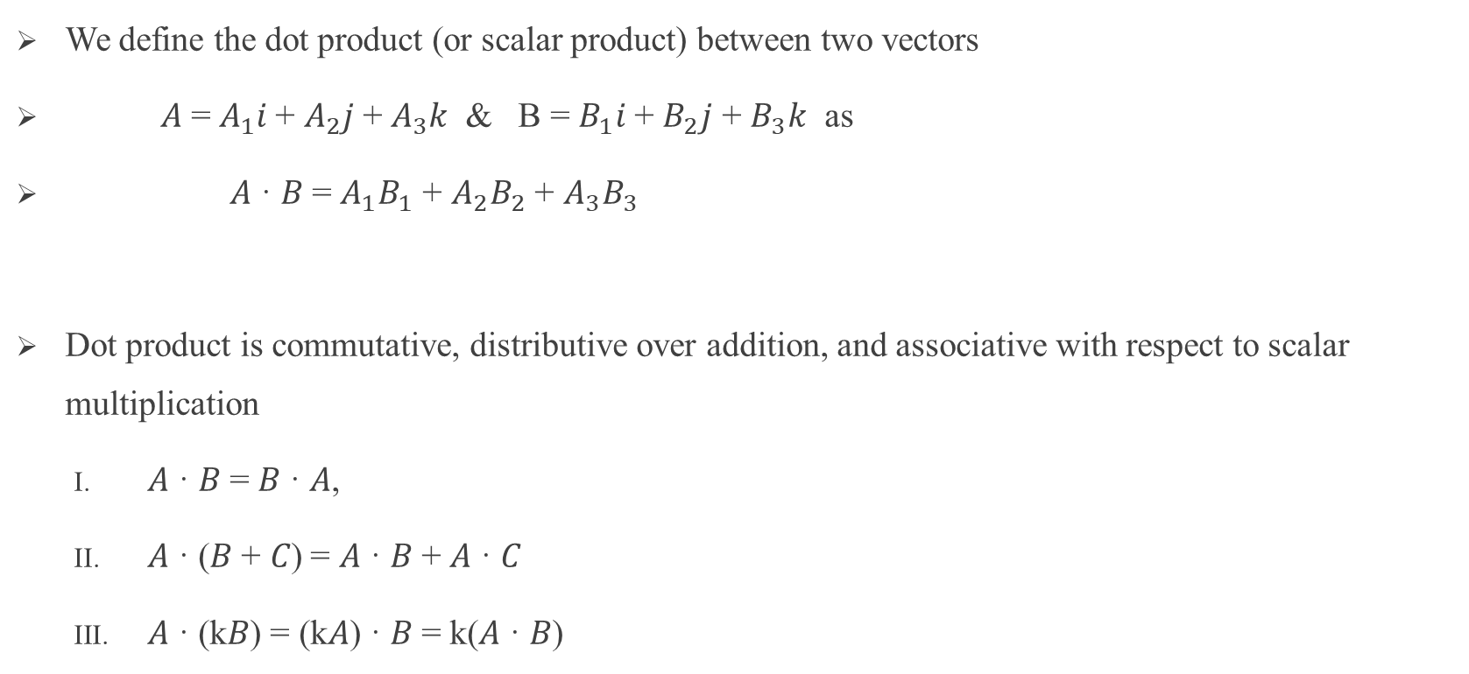
Scalar Product

Slide 6
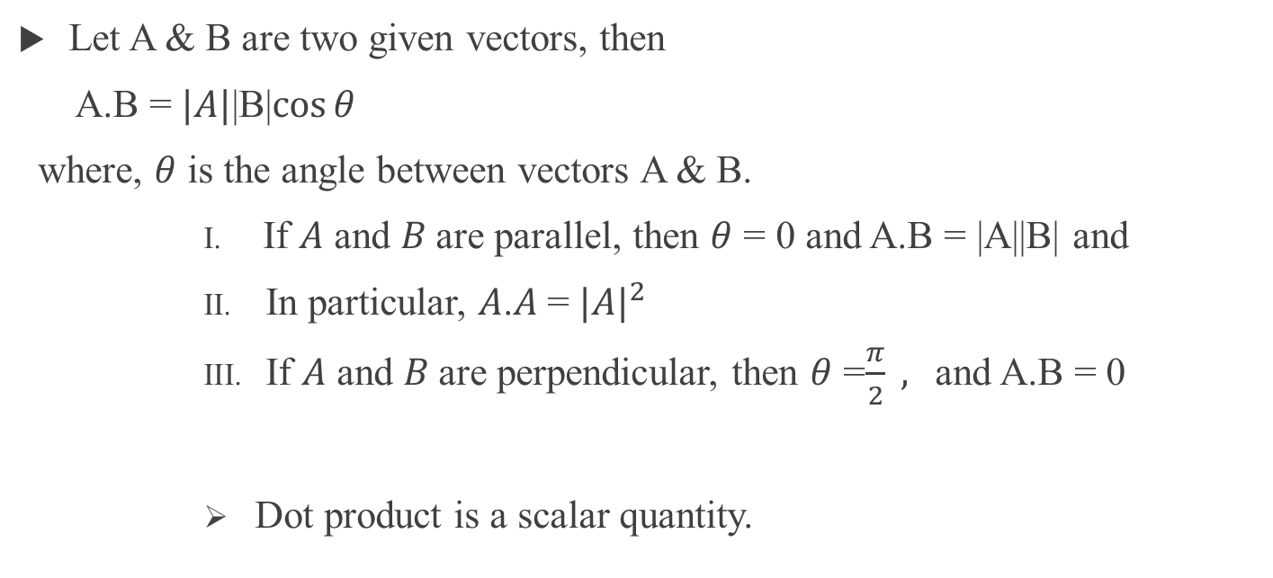
Geometric interpretation of the dot product

Slide 7
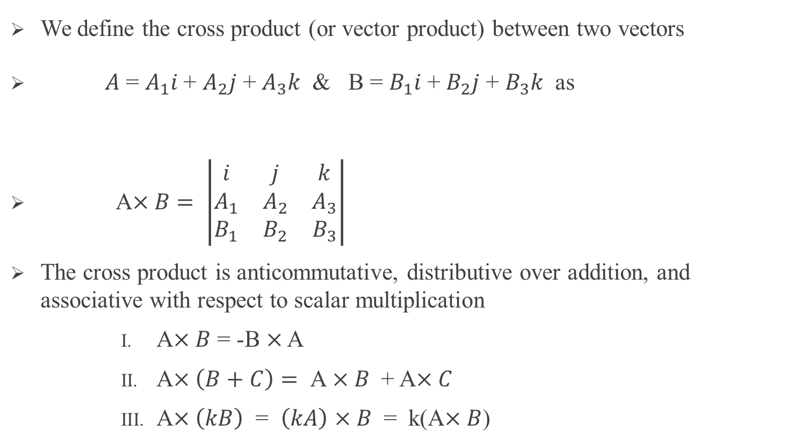
Vector Product (Cross product)

Slide 8
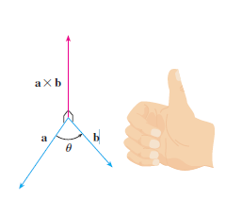
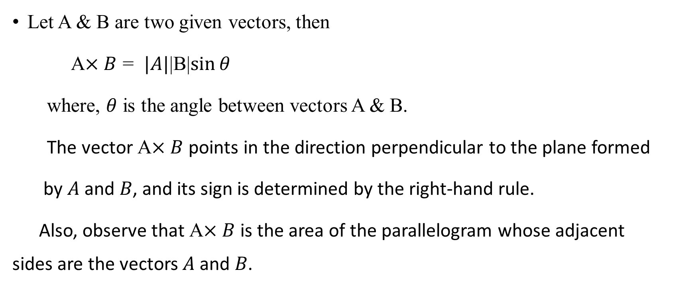
Geometric interpretation of the cross product

Slide 9
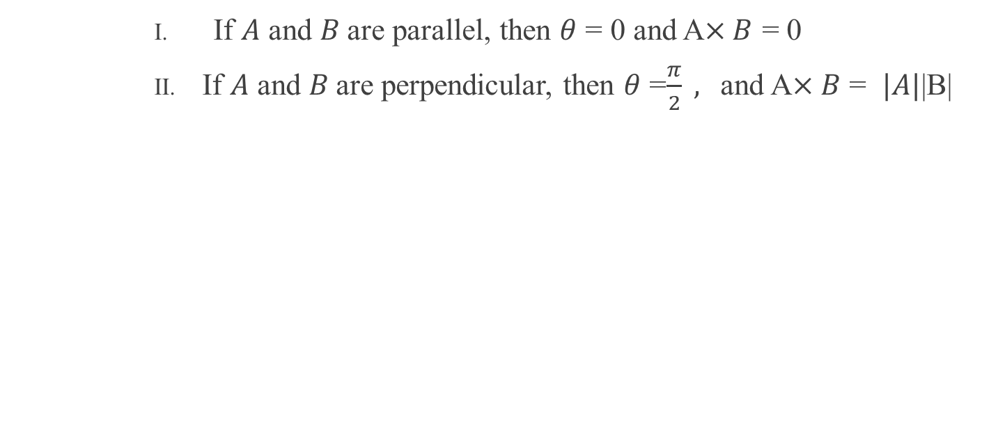

Slide 10
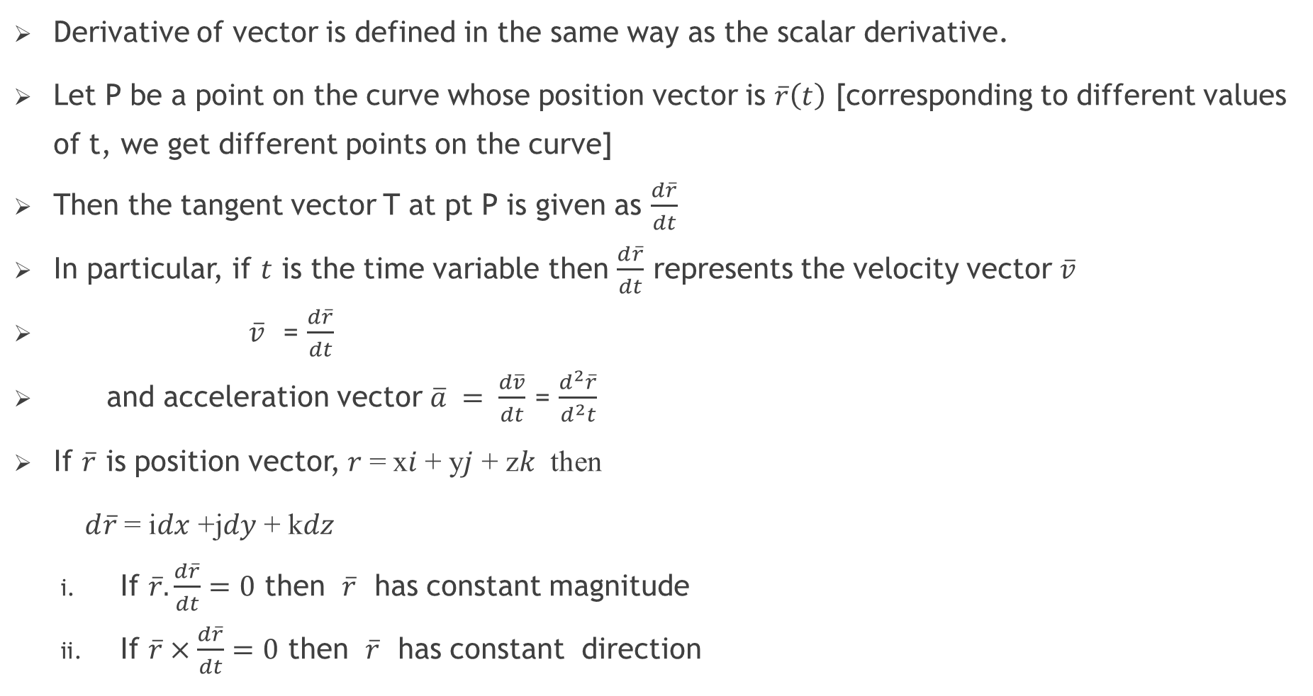
Vector Differentiation

Slide 11
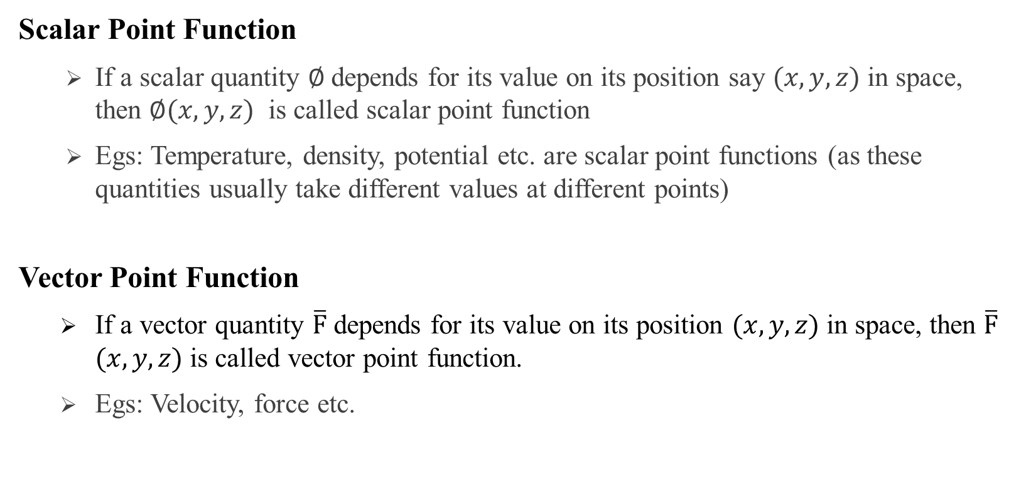

Slide 12
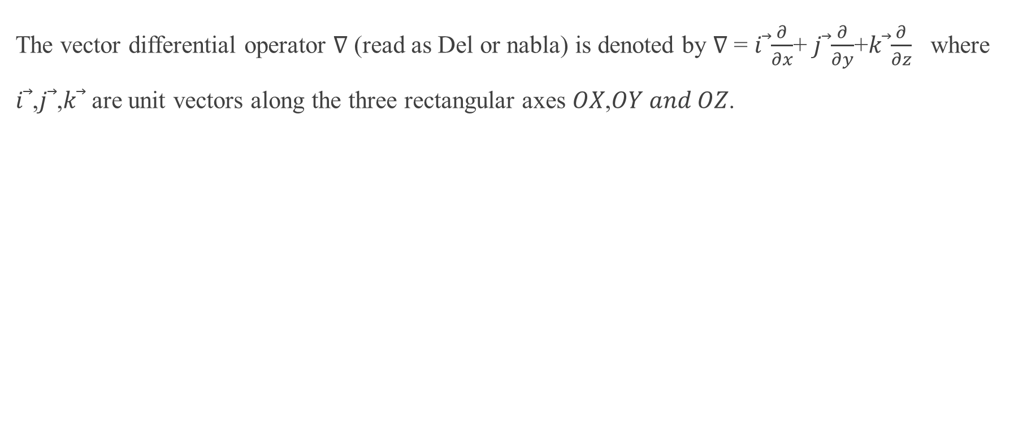
Operator ‘Del’ or ‘Nabla’

Slide 13
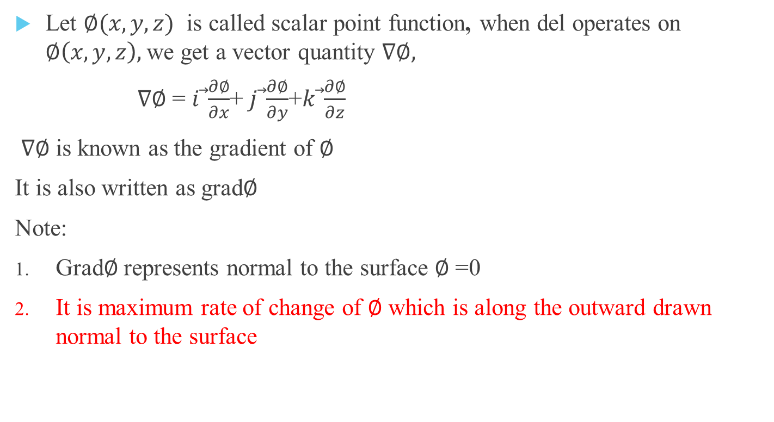
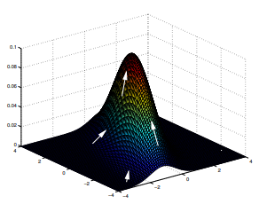
The gradient of a scalar function

Slide 14
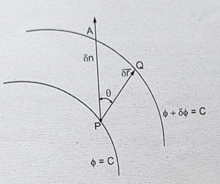
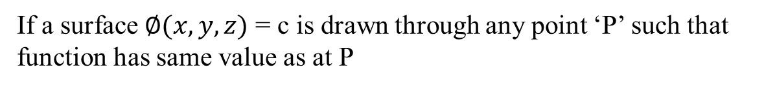
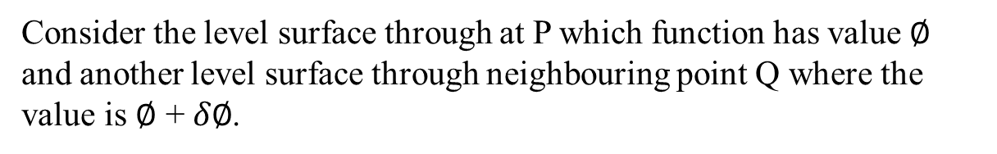
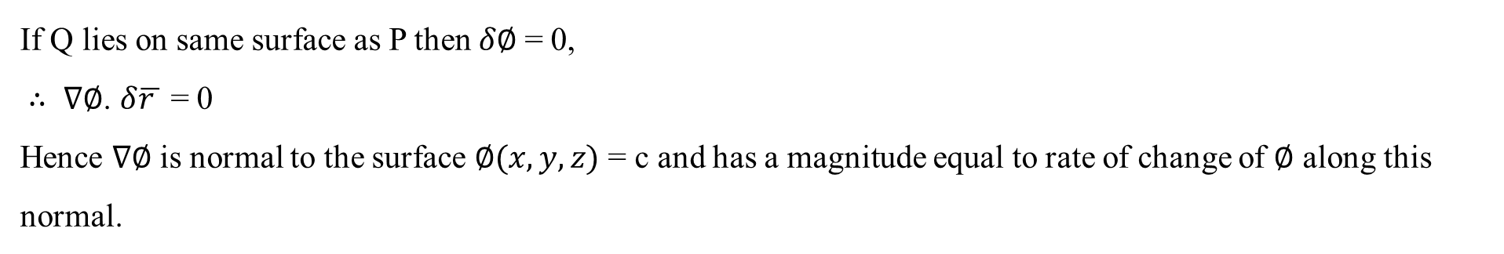
Geometrical Interpretation of Gradient

Slide 15
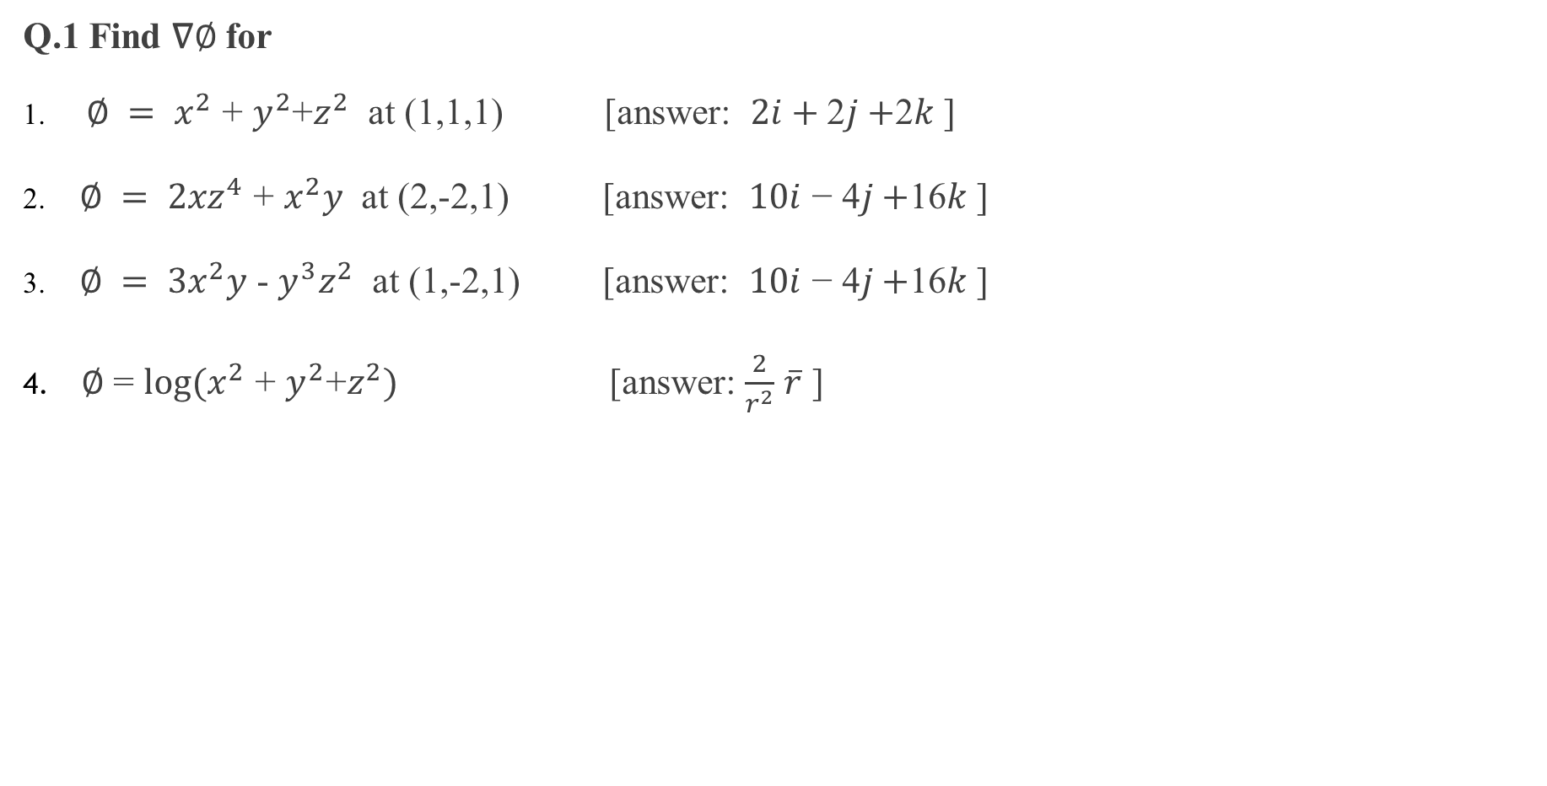
Examples on Gradient

Slide 16
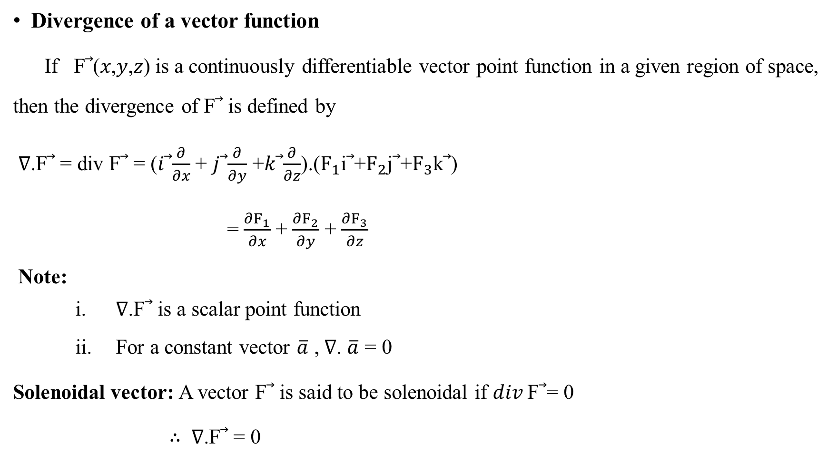
Divergence and Curl

Slide 17
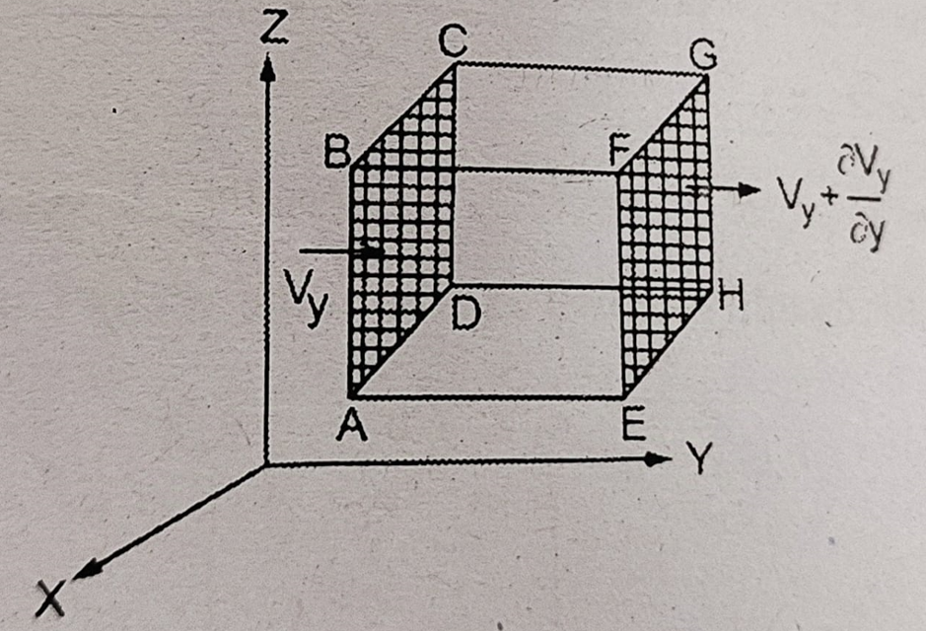
Physical Interpretation of Divergence
The divergence of a vector point function representing any physical quantity represent the rate of outward flow through unit volume.

Slide 18
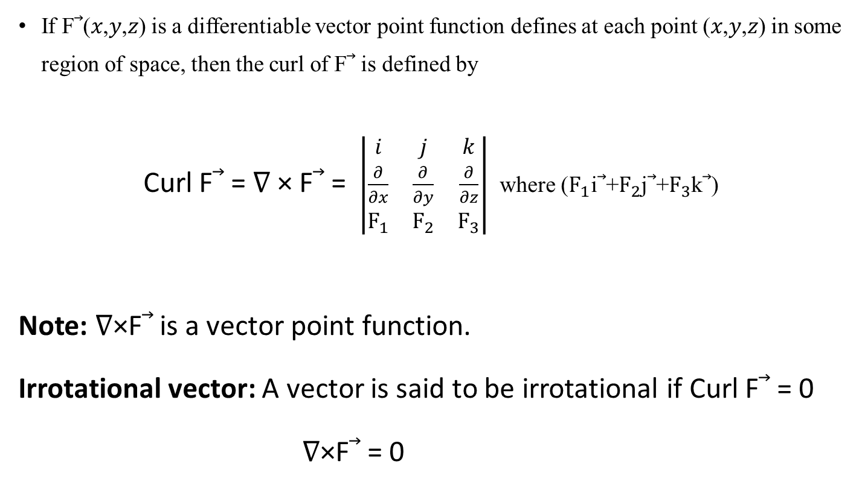
Curl of a vector function

Slide 19
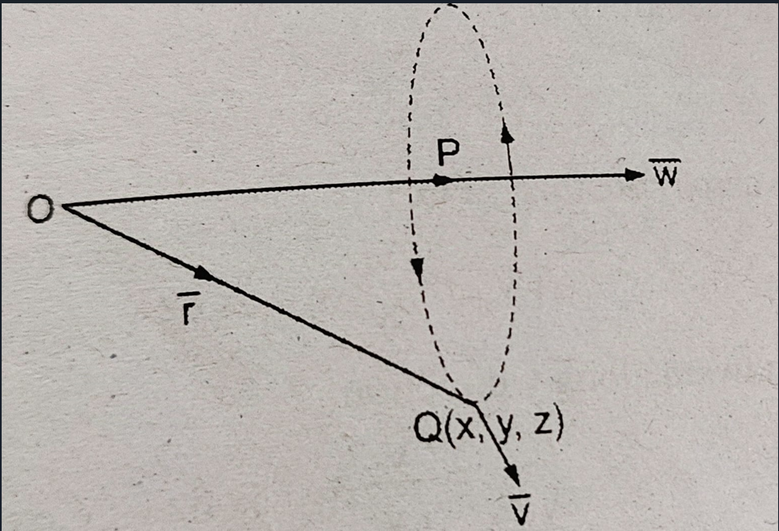
Physical Interpretation of Curl
The angular velocity of rotation is equal to half the curl of velocity vector.
Hence the curl signifies rotation.
In general, the curl of any vector point function gives the measure of the angular velocity at any point of the vector field

Slide 20
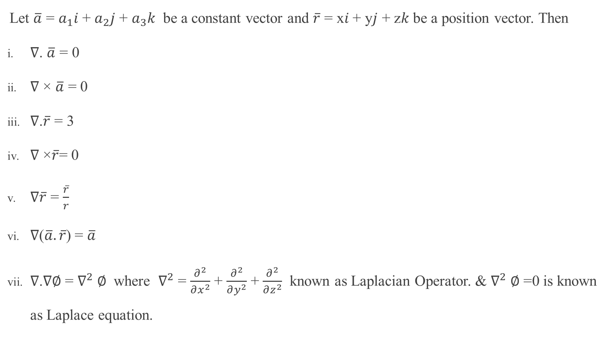
Some Standard Results

Slide 21
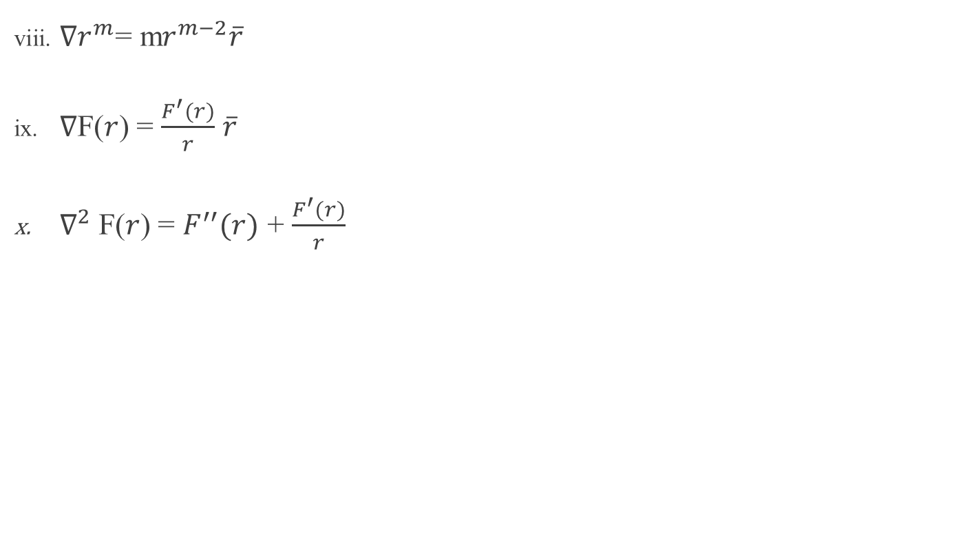
Some Standard Results

Slide 22
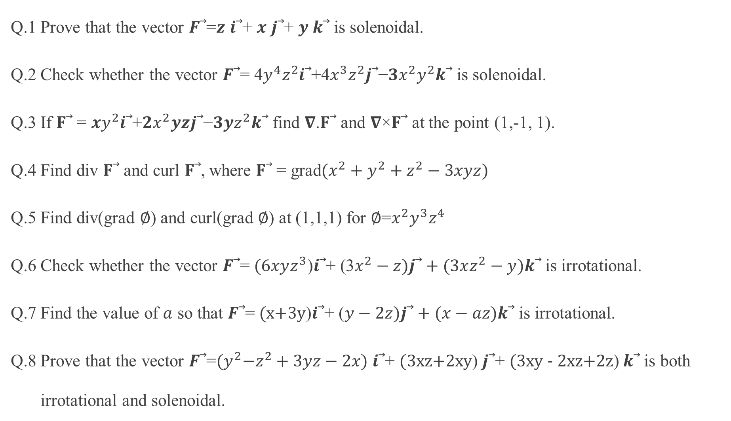
Examples

Slide 23
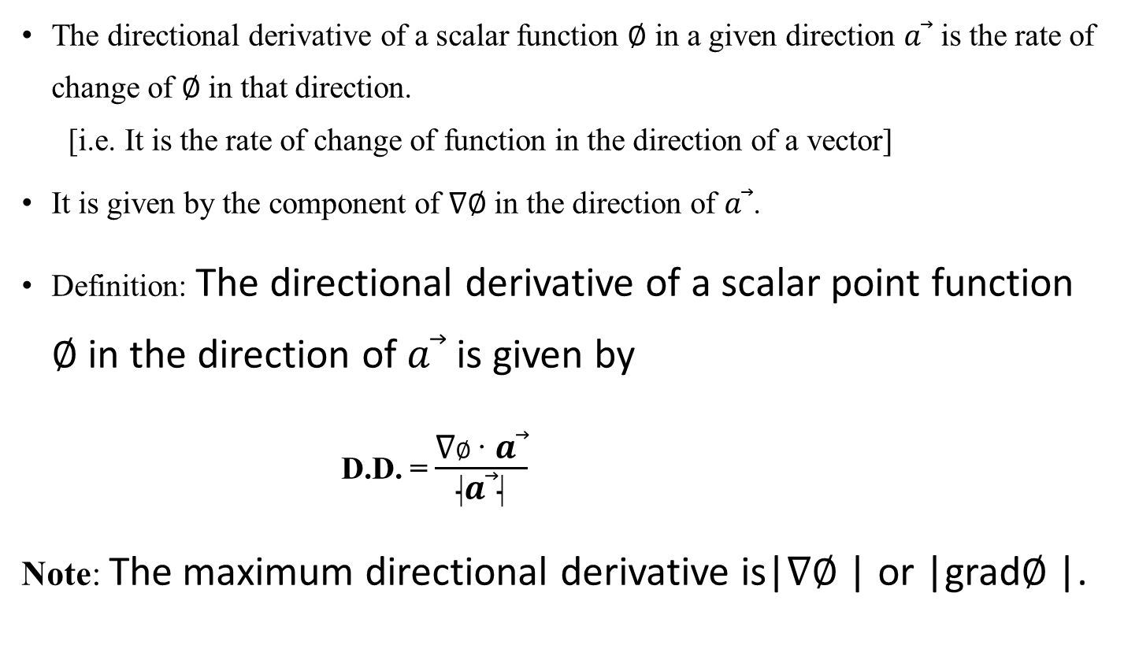
Directional Derivative (D.D) of a scalar point function

Slide 24
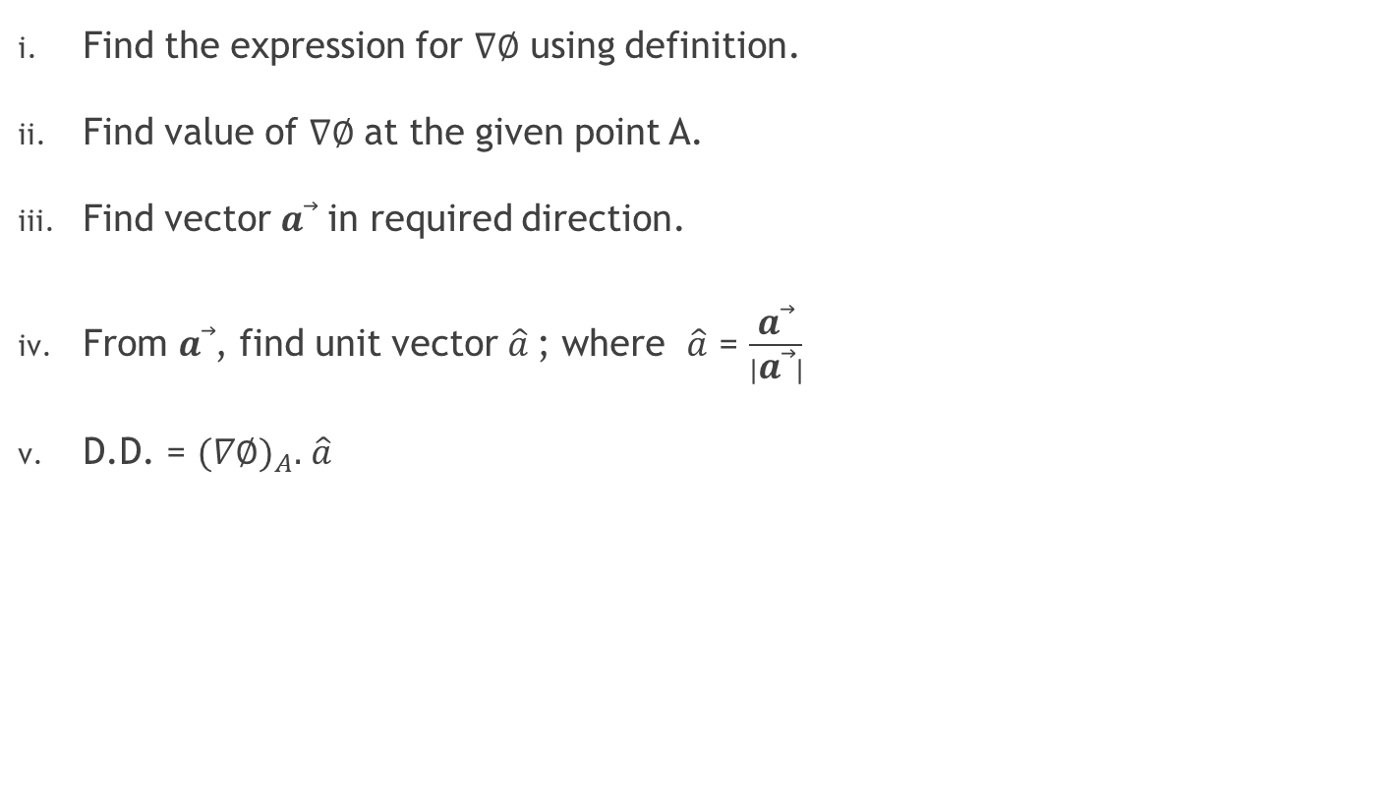
Steps for finding D.D.

Slide 25
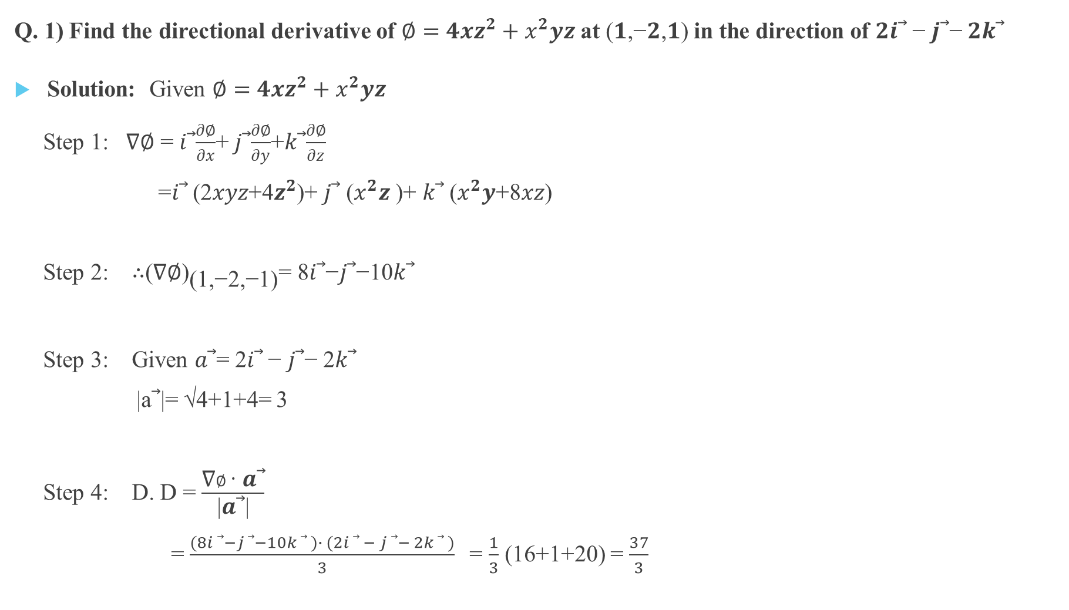
Examples on D. D.

Slide 26
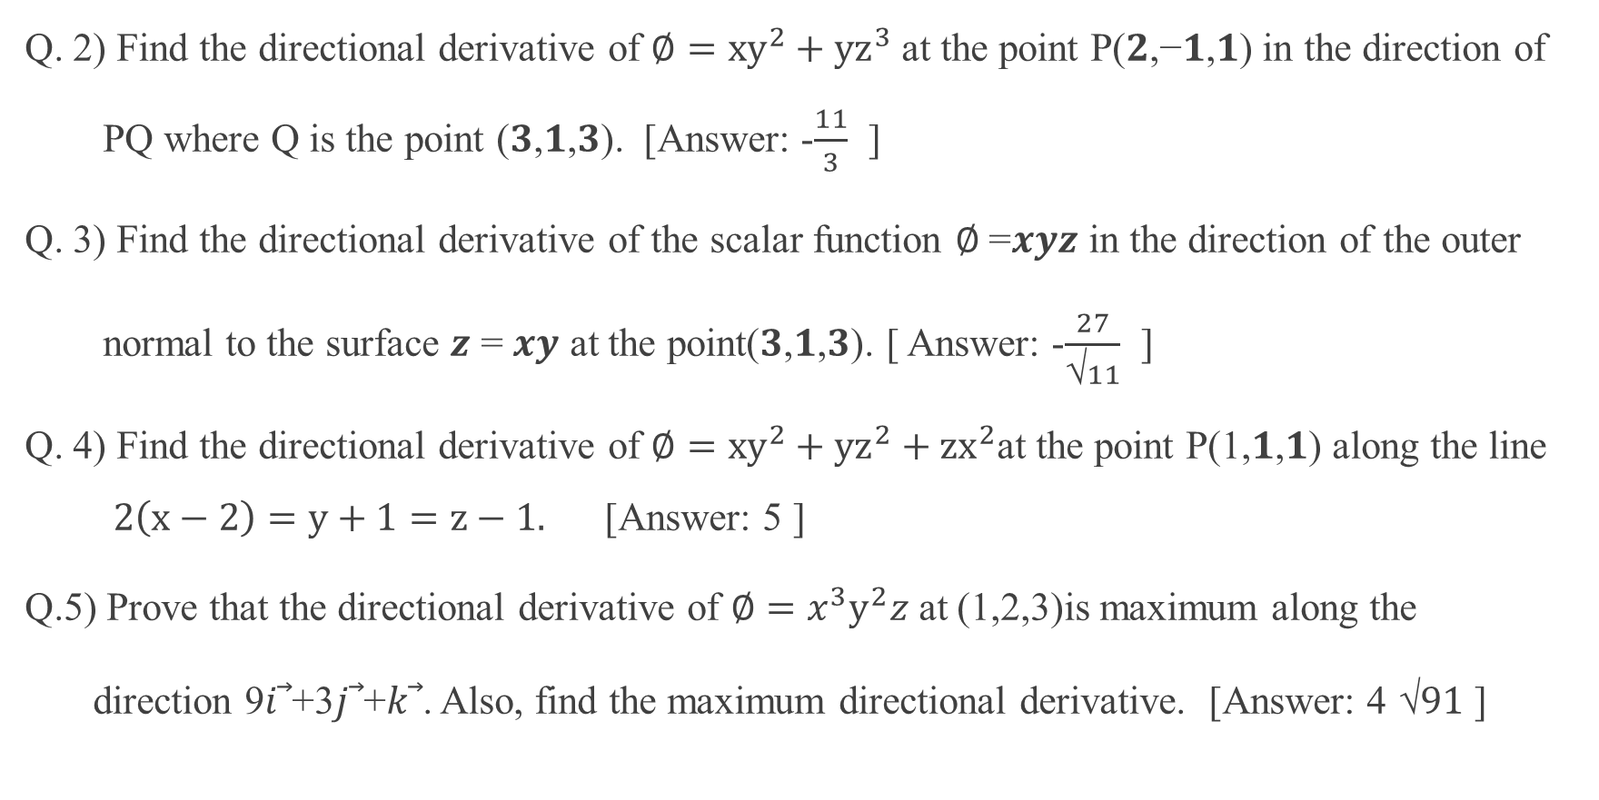

Slide 27
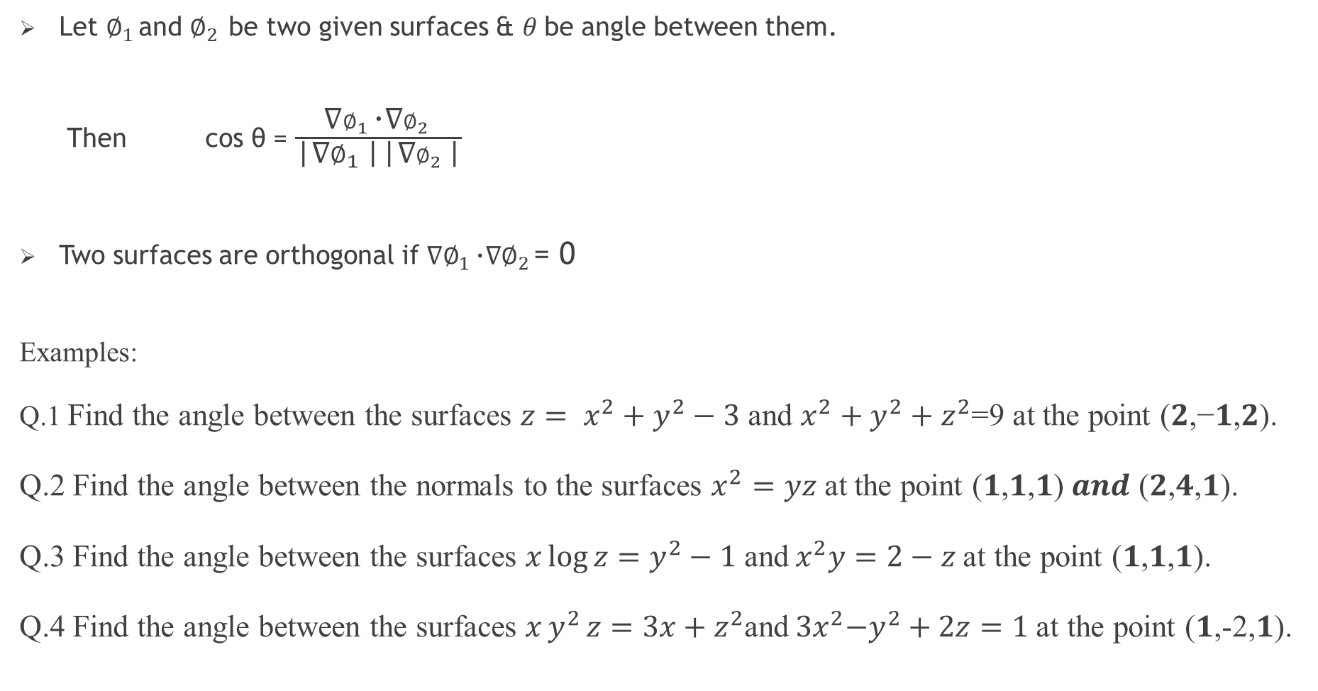
Angle between the surfaces

Slide 28
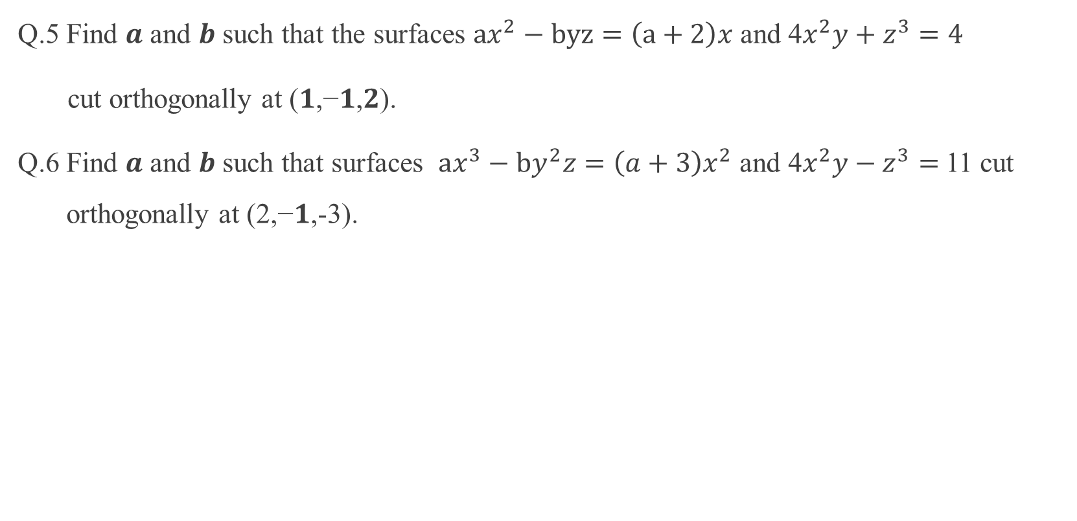

Slide 29
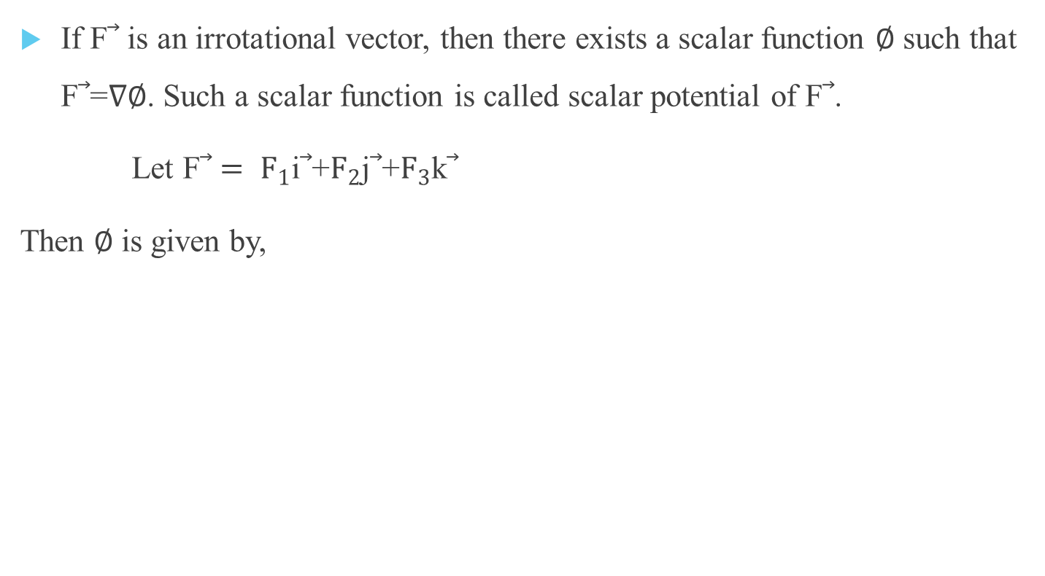
Scalar potential

Slide 30
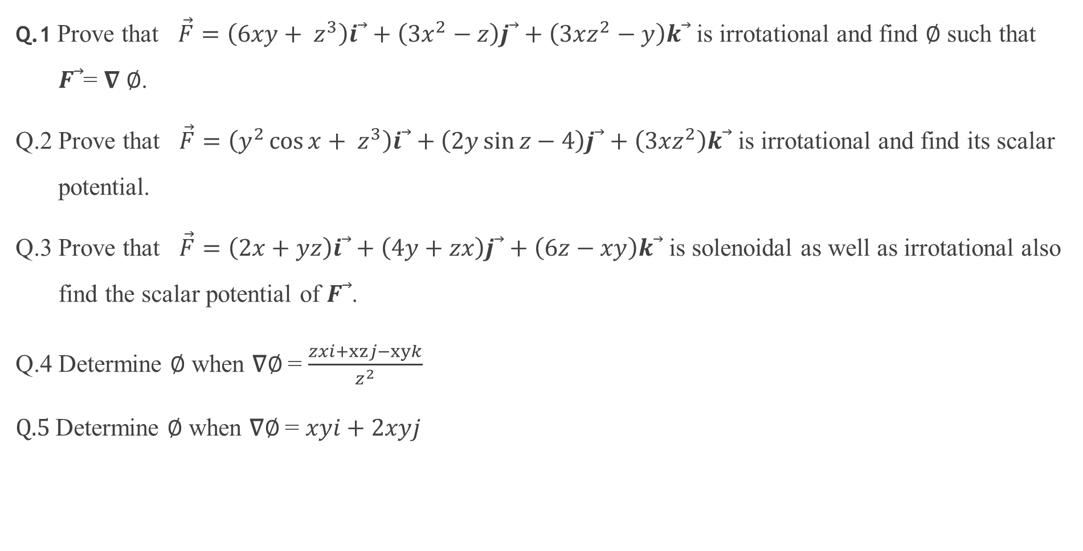
Examples

